Slide 1
Multiple Sequence Alignment
Kun-Mao Chao (趙坤茂)
Department of Computer Science and Information Engineering
National Taiwan University, Taiwan
WWW: http://www.csie.ntu.edu.tw/~kmchao

Slide 2
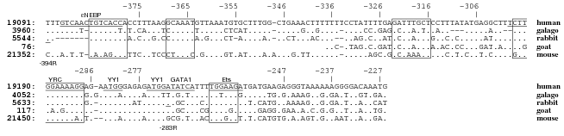
MSA

Slide 3
Multiple sequence alignment (MSA)
The multiple sequence alignment problem is to simultaneously align more than two sequences.
Seq1: GCTC
Seq2: AC
Seq3: GATC
GC-TC
A---C
G-ATC

Slide 4
How to score an MSA?
Sum-of-Pairs (SP-score)
GC-TC
A---C
Score
GC-TC
A---C
G-ATC
+
GC-TC
G-ATC
Score
Score
=
+
A---C
G-ATC
Score

Slide 5

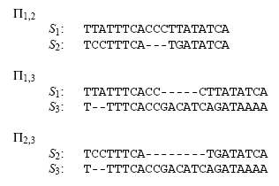

Slide 6

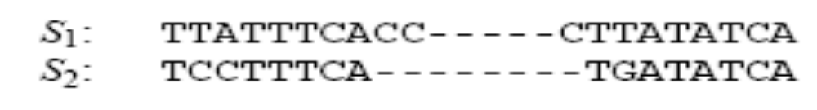
Gaps

Slide 7
MSA for three sequences
an O(n³) algorithm

Slide 8
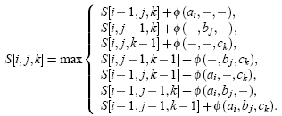
MSA for three sequences

Slide 9
General MSA
For k sequences of length n: O(n^{k})
NP-Complete (Wang and Jiang)
The exact multiple alignment algorithms for many sequences are not feasible.
Some approximation algorithms are given.
(e.g., 2- l/k for any fixed l by Bafna et al.)

Slide 10
Progressive alignment
A heuristic approach proposed by Feng and Doolittle.
It iteratively merges the most similar pairs.
“Once a gap, always a gap”
The time for progressive alignment in most cases is roughly the order of the time for computing all pairwise alignment, i.e., O(k²n²), where k is the number of sequences and n is the length of the alignment.
A B C D E

Slide 11
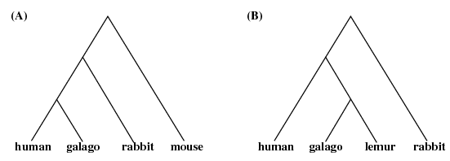
The Guide Trees

Slide 12
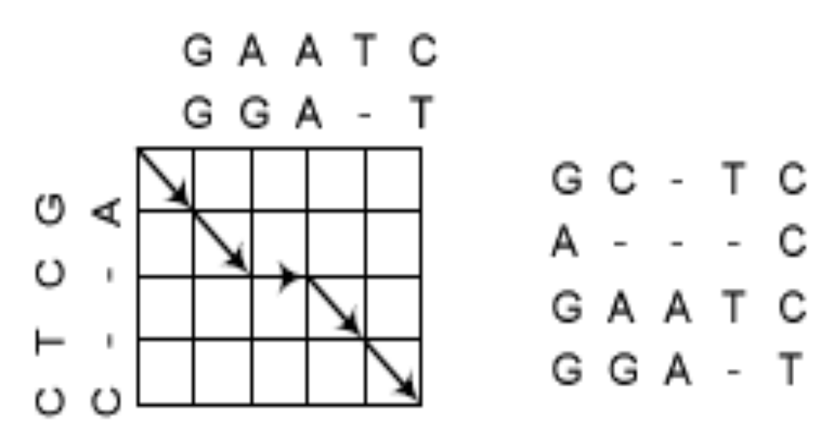
Aligning Alignments
It can be seen that a path in the alignment graph corresponds to an alignment of the two alignments. Note that the path in this example may not be optimal.

Slide 13
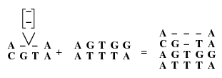
Affine Gaps
For affine gap penalties, the computation of the current column does not depend simply on its previous column.

Slide 14
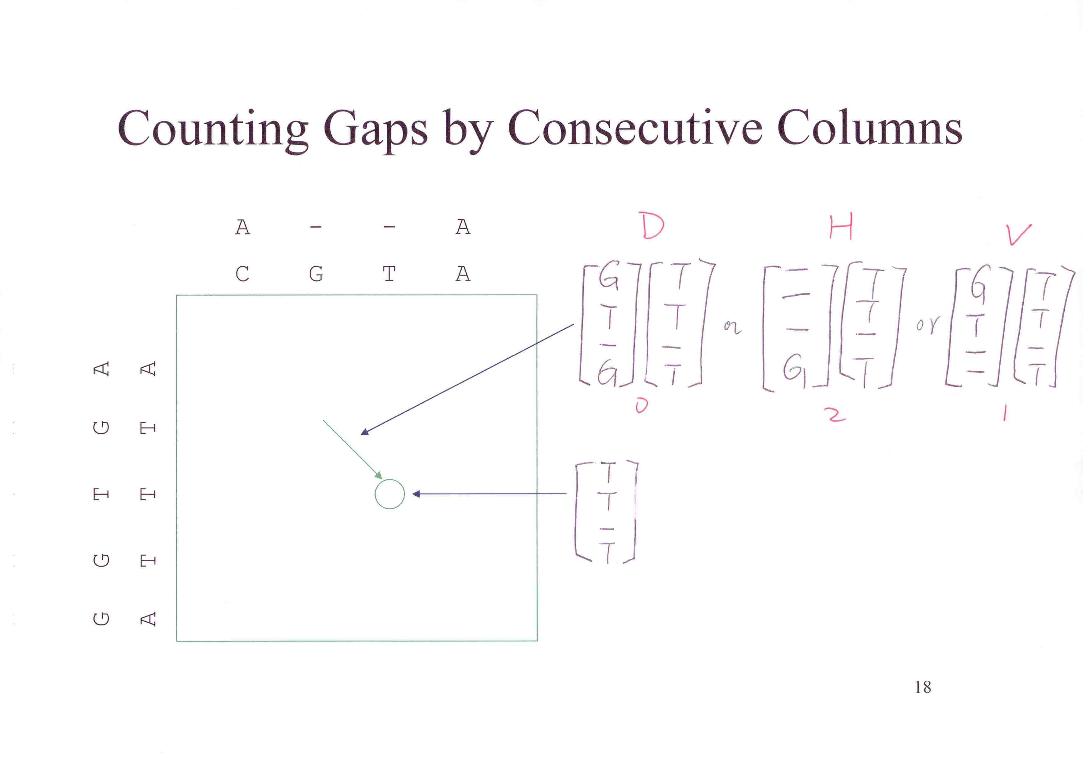

Slide 15
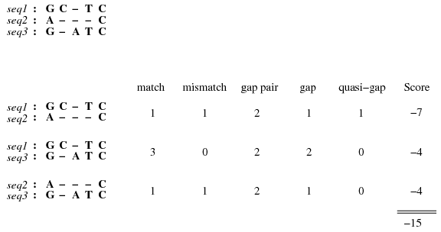
Quasi-Gaps
match: +1, mismatch:-1, gap-pair:-0.5, gap(penality):-3

Slide 16

Gap Starts & Gap Ends

Slide 17
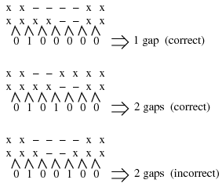
Gaps

Slide 18
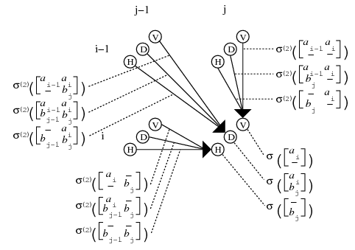
Nine Ways In

Slide 19
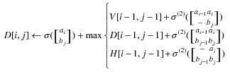
D[i, j]

